Slide 1
Machine Learning 3/6
2015.12.31(목)
박지현

Slide 2
Advice for Applying Machine Learning
Evaluating a Learning Algorithm
Bias vs. Variance
Machine Learning System Design
Building a Spam Classifier
Handling Skewed Data
Using Large Data Sets
Support Vector Machines
Large Margin Classification
Kernels
SVMs in Practice

Slide 3
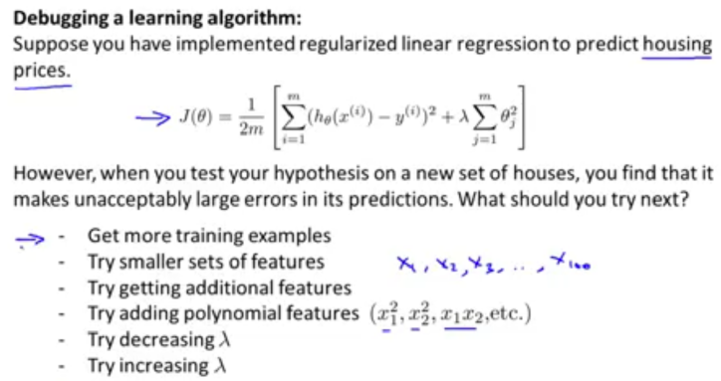
Advice for Applying Machine Learning
상세 내용
Evaluating a Learning Algorithm

Slide 4
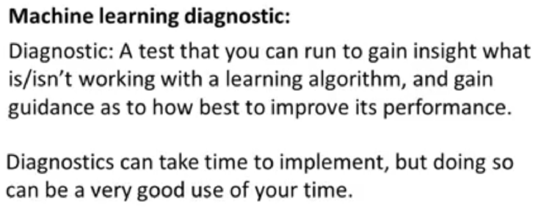
Advice for Applying Machine Learning
상세 내용
Evaluating a Learning Algorithm

Slide 5
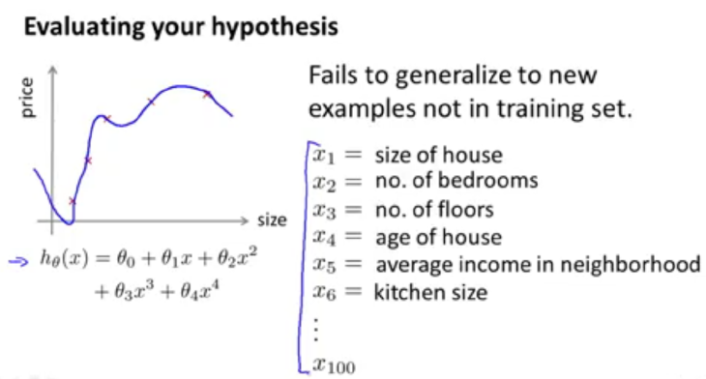
Advice for Applying Machine Learning
상세 내용
Evaluating a Learning Algorithm

Slide 6
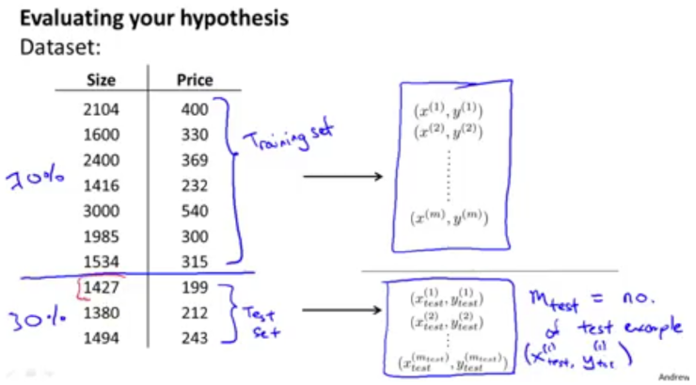
Advice for Applying Machine Learning
상세 내용
Evaluating a Learning Algorithm

Slide 7
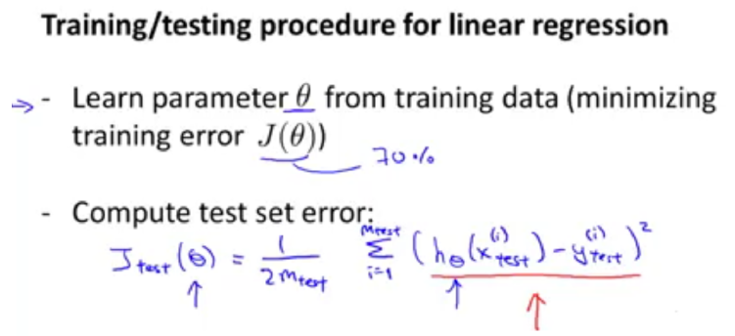
Advice for Applying Machine Learning
상세 내용
Evaluating a Learning Algorithm

Slide 8
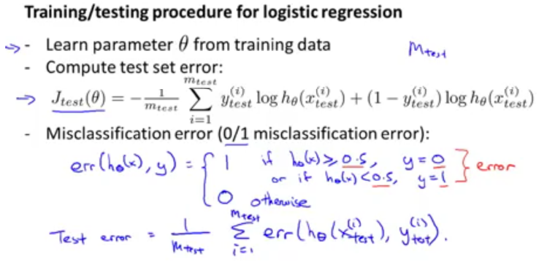
Advice for Applying Machine Learning
상세 내용
Evaluating a Learning Algorithm

Slide 9
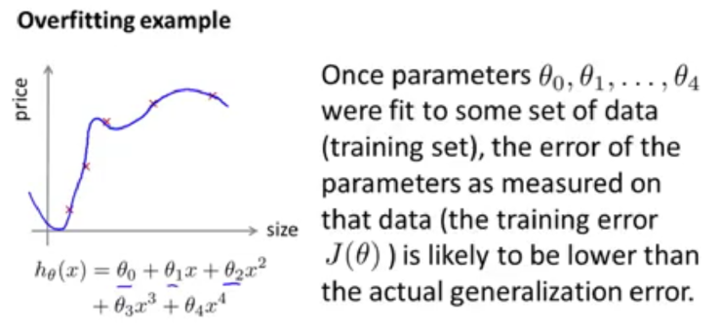
Advice for Applying Machine Learning
상세 내용
Evaluating a Learning Algorithm

Slide 10
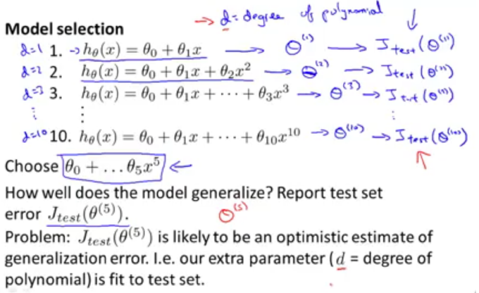
Advice for Applying Machine Learning
상세 내용
Evaluating a Learning Algorithm

Slide 11
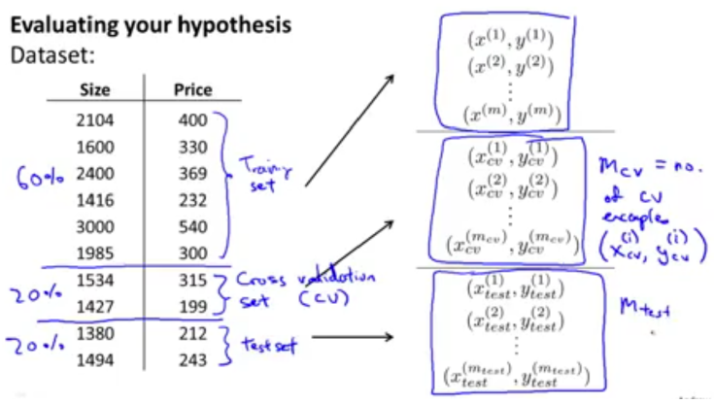
Advice for Applying Machine Learning
상세 내용
Evaluating a Learning Algorithm

Slide 12
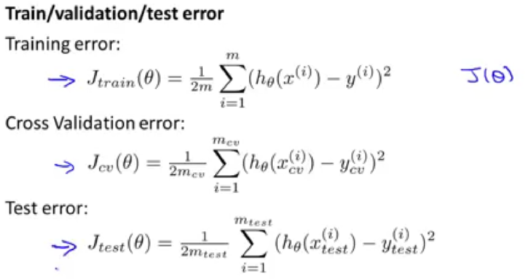
Advice for Applying Machine Learning
상세 내용
Evaluating a Learning Algorithm

Slide 13
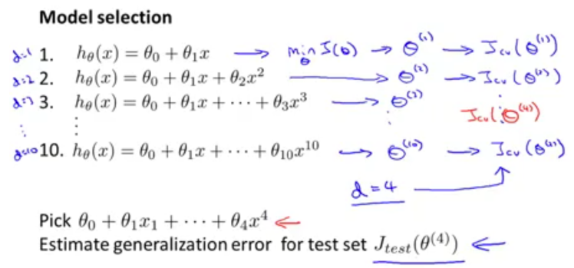
Advice for Applying Machine Learning
상세 내용
Evaluating a Learning Algorithm

Slide 14
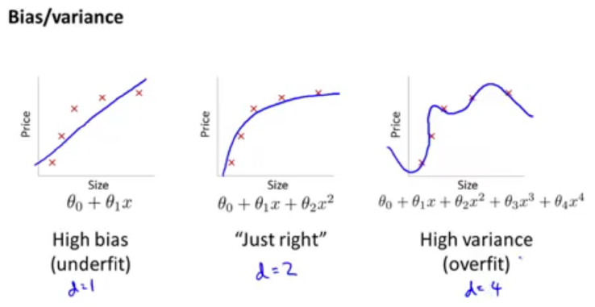
Advice for Applying Machine Learning
상세 내용
Evaluating a Learning Algorithm

Slide 15
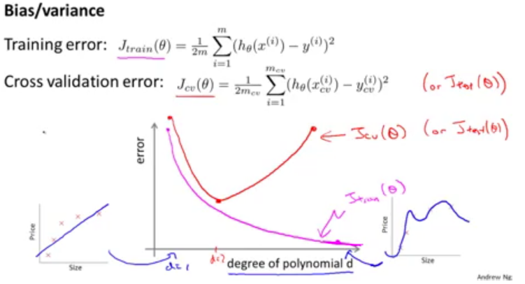
Advice for Applying Machine Learning
상세 내용
Evaluating a Learning Algorithm

Slide 16
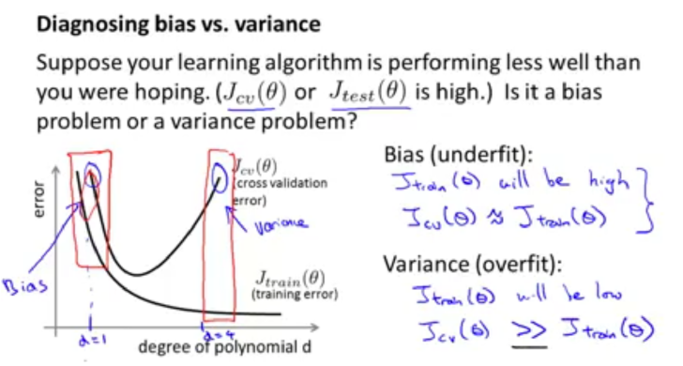
Advice for Applying Machine Learning
상세 내용
Evaluating a Learning Algorithm

Slide 17
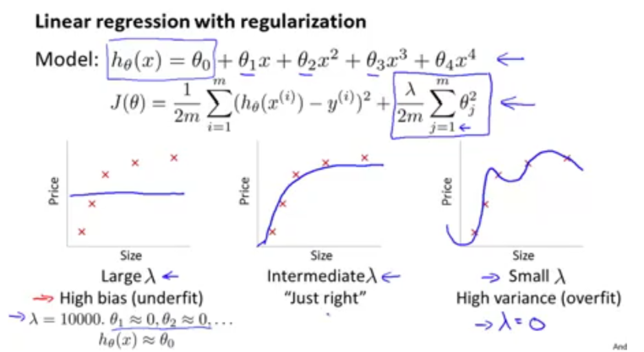
Advice for Applying Machine Learning
상세 내용
Evaluating a Learning Algorithm

Slide 18
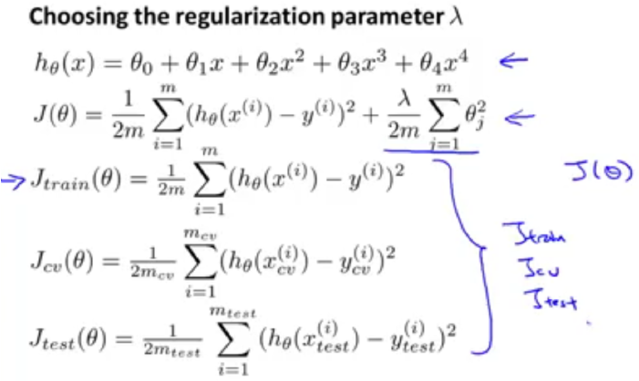
Advice for Applying Machine Learning
상세 내용
Evaluating a Learning Algorithm

Slide 19
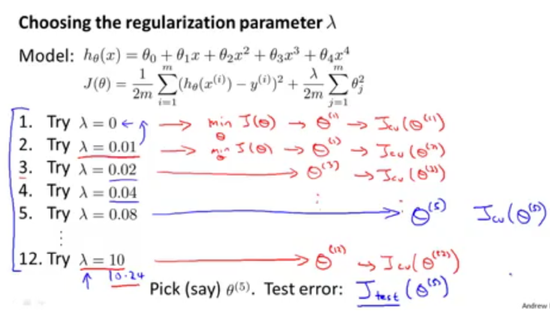
Advice for Applying Machine Learning
상세 내용
Evaluating a Learning Algorithm

Slide 20
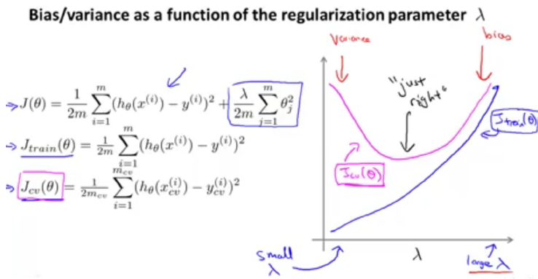
Advice for Applying Machine Learning
상세 내용
Evaluating a Learning Algorithm

Slide 21
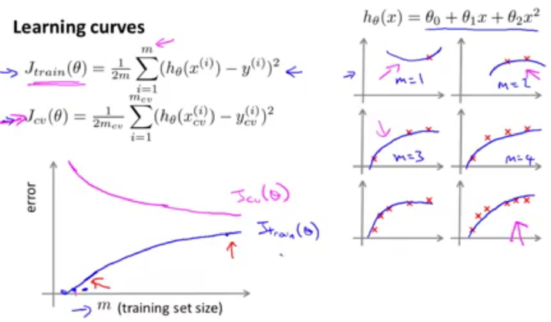
Advice for Applying Machine Learning
상세 내용
Evaluating a Learning Algorithm

Slide 22
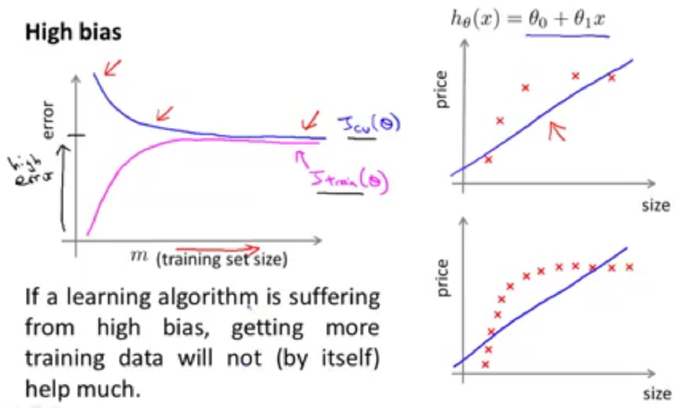
Advice for Applying Machine Learning
상세 내용
Evaluating a Learning Algorithm

Slide 23
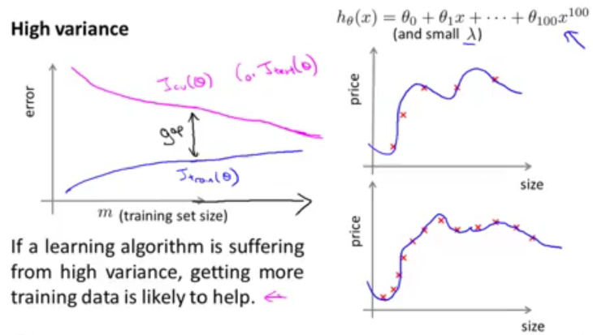
Advice for Applying Machine Learning
상세 내용
Evaluating a Learning Algorithm

Slide 24
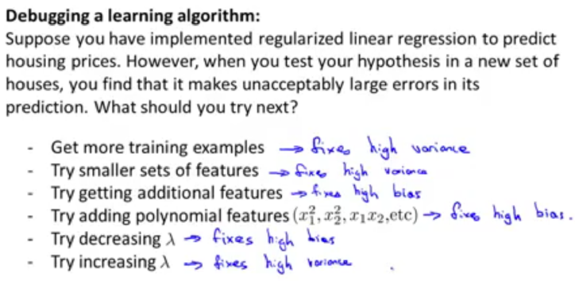
Advice for Applying Machine Learning
상세 내용
Evaluating a Learning Algorithm

Slide 25
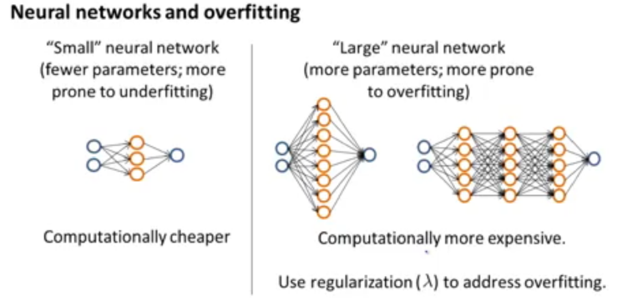
Advice for Applying Machine Learning
상세 내용
Evaluating a Learning Algorithm

Slide 26
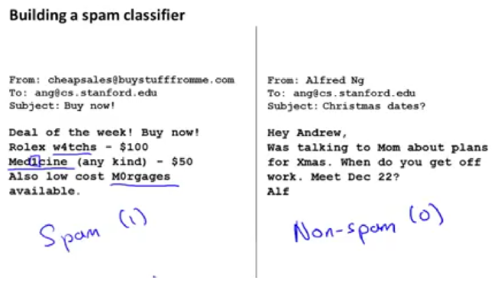
Advice for Applying Machine Learning
상세 내용
Evaluating a Learning Algorithm

Slide 27
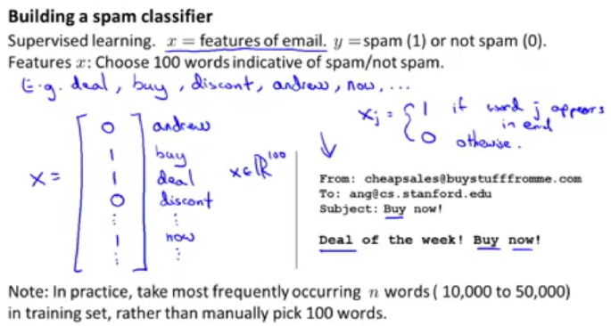
Advice for Applying Machine Learning
상세 내용
Evaluating a Learning Algorithm

Slide 28
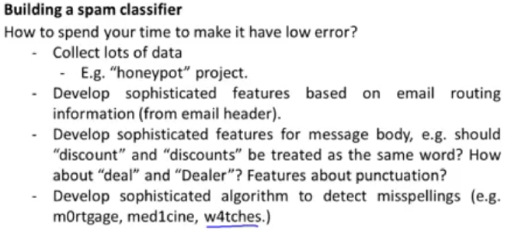
Advice for Applying Machine Learning
상세 내용
Evaluating a Learning Algorithm

Slide 29
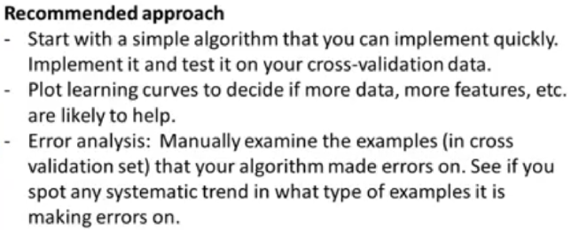
Advice for Applying Machine Learning
상세 내용
Evaluating a Learning Algorithm

Slide 30
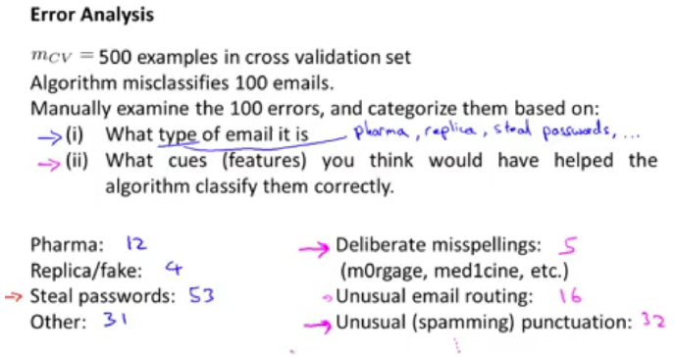
Advice for Applying Machine Learning
상세 내용
Evaluating a Learning Algorithm

Slide 31
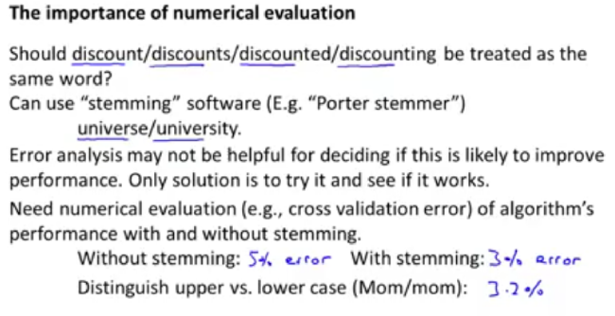
Advice for Applying Machine Learning
상세 내용
Evaluating a Learning Algorithm

Slide 32
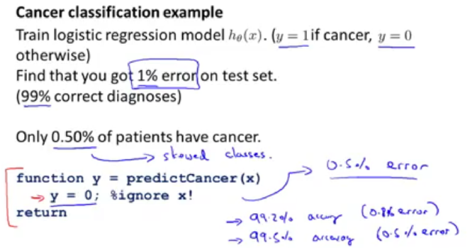
Advice for Applying Machine Learning
상세 내용
Evaluating a Learning Algorithm

Slide 33
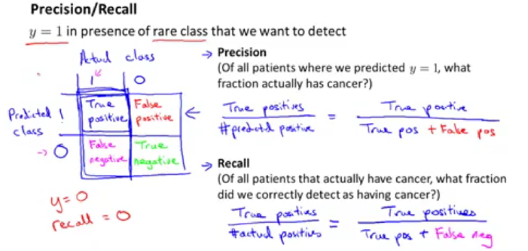
Advice for Applying Machine Learning
상세 내용
Evaluating a Learning Algorithm

Slide 34
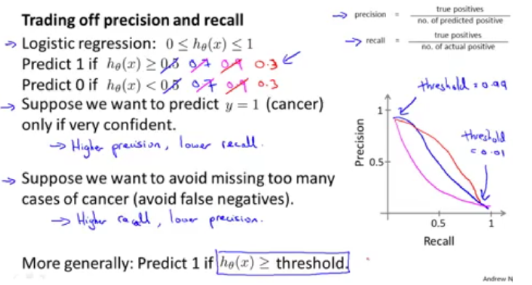
Advice for Applying Machine Learning
상세 내용
Evaluating a Learning Algorithm

Slide 35
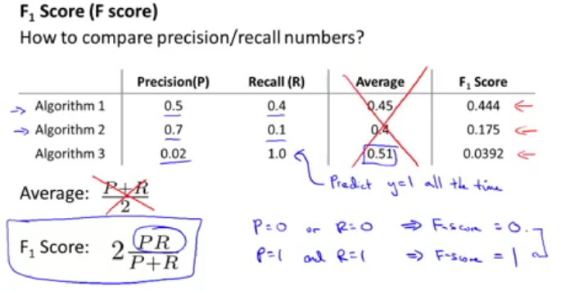
Advice for Applying Machine Learning
상세 내용
Evaluating a Learning Algorithm

Slide 36
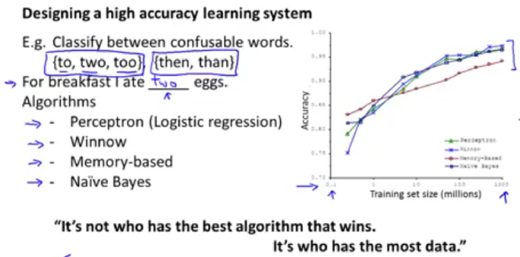
Advice for Applying Machine Learning
상세 내용
Evaluating a Learning Algorithm

Slide 37
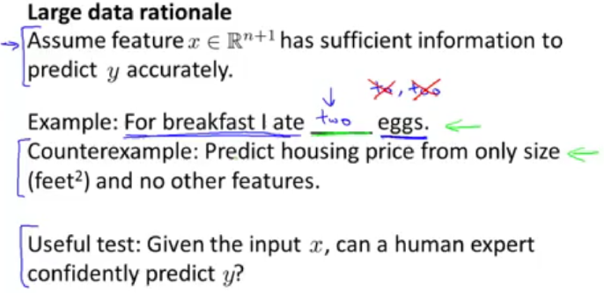
Advice for Applying Machine Learning
상세 내용
Evaluating a Learning Algorithm

Slide 38
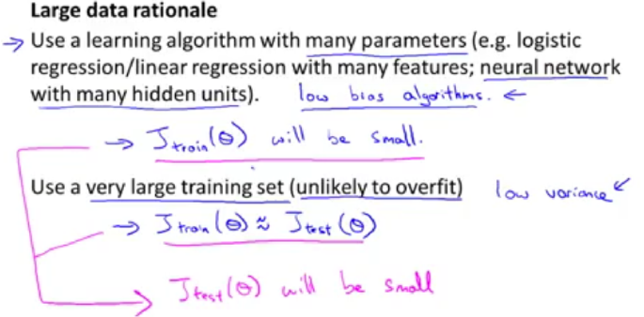
Advice for Applying Machine Learning
상세 내용
Evaluating a Learning Algorithm

Slide 39
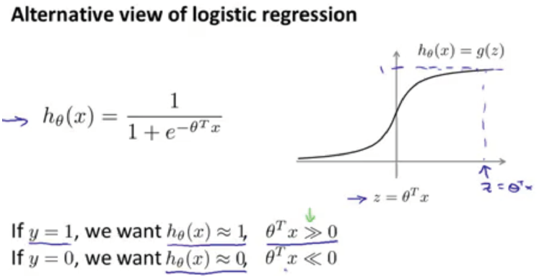
Advice for Applying Machine Learning
상세 내용
Evaluating a Learning Algorithm

Slide 40
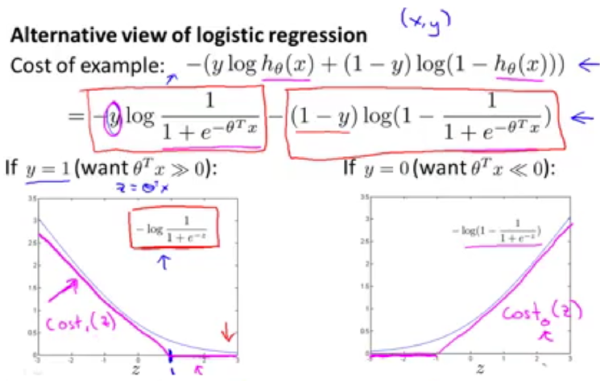
Advice for Applying Machine Learning
상세 내용
Evaluating a Learning Algorithm

Slide 41
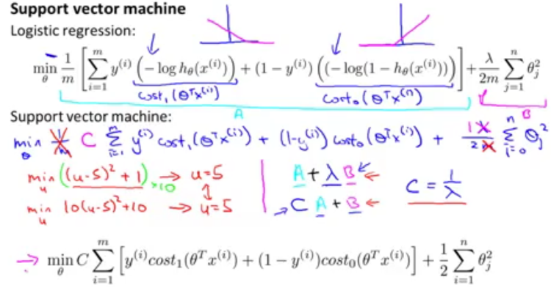
Advice for Applying Machine Learning
상세 내용
Evaluating a Learning Algorithm

Slide 42
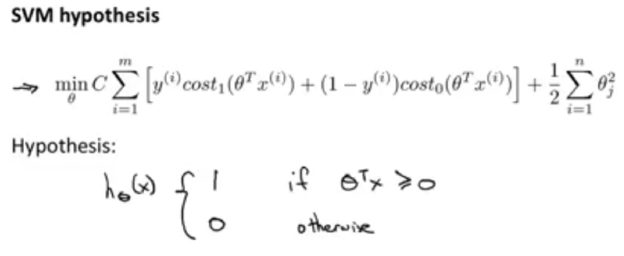
Advice for Applying Machine Learning
상세 내용
Evaluating a Learning Algorithm

Slide 43
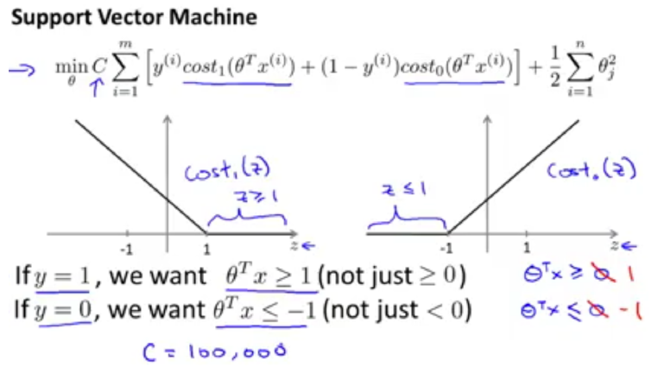
Advice for Applying Machine Learning
상세 내용
Evaluating a Learning Algorithm

Slide 44
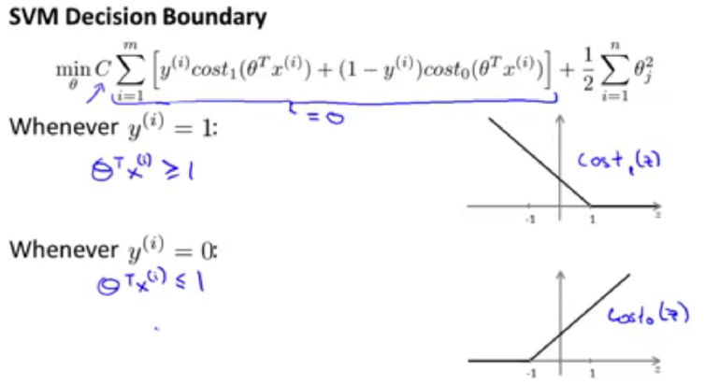
Advice for Applying Machine Learning
상세 내용
Evaluating a Learning Algorithm

Slide 45
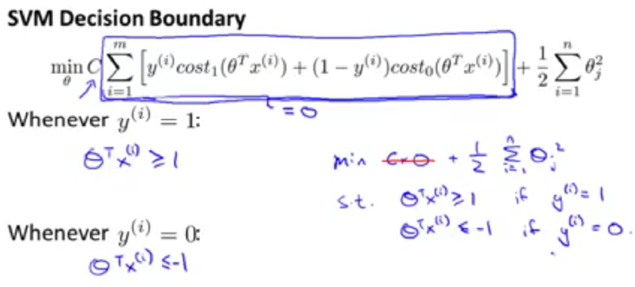
Advice for Applying Machine Learning
상세 내용
Evaluating a Learning Algorithm

Slide 46
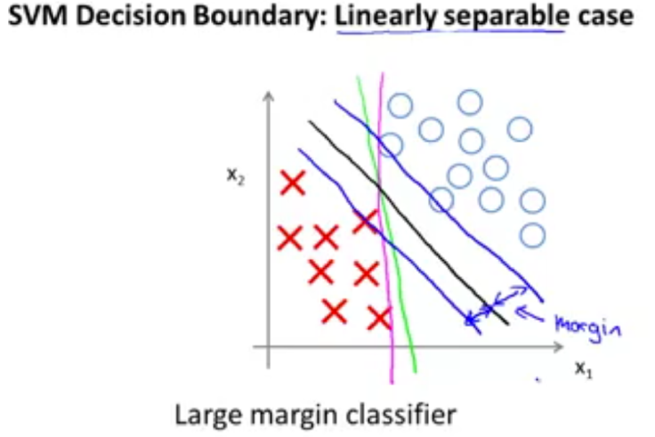
Advice for Applying Machine Learning
상세 내용
Evaluating a Learning Algorithm

Slide 47
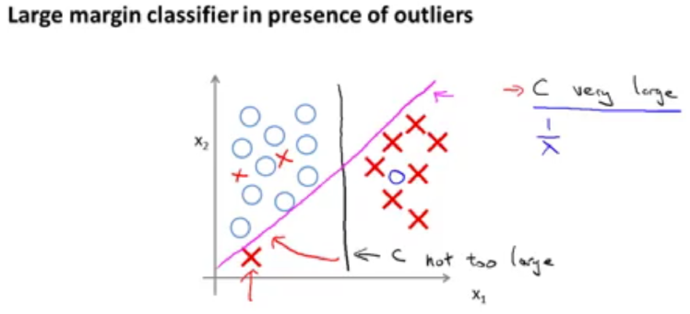
Advice for Applying Machine Learning
상세 내용
Evaluating a Learning Algorithm

Slide 48
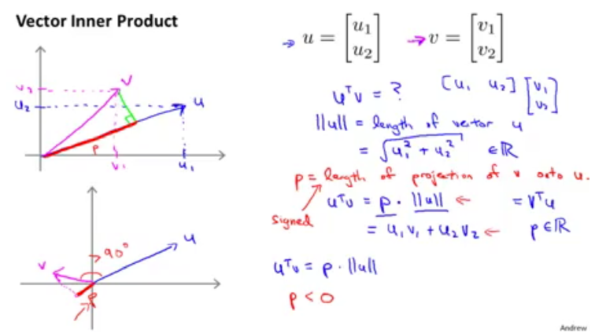
Advice for Applying Machine Learning
상세 내용
Evaluating a Learning Algorithm

Slide 49
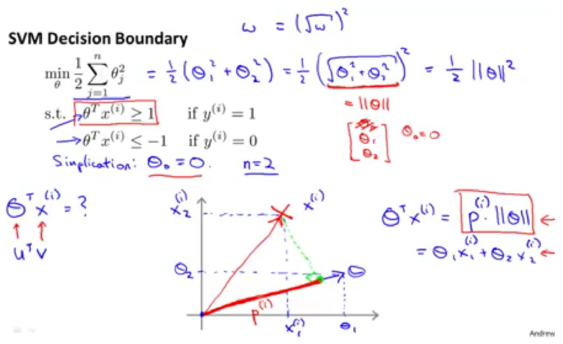
Advice for Applying Machine Learning
상세 내용
Evaluating a Learning Algorithm

Slide 50
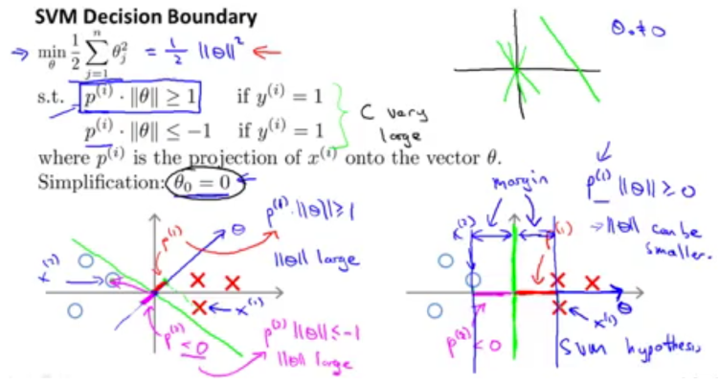
Advice for Applying Machine Learning
상세 내용
Evaluating a Learning Algorithm

Slide 51
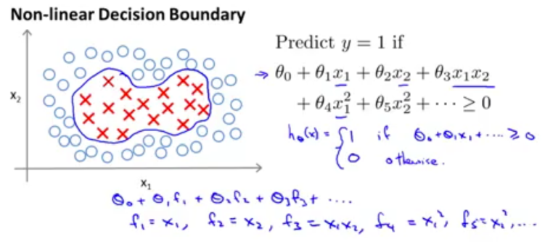
Advice for Applying Machine Learning
상세 내용
Evaluating a Learning Algorithm

Slide 52
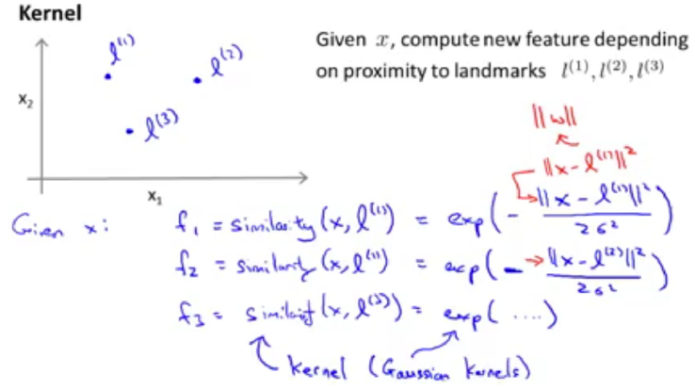
Advice for Applying Machine Learning
상세 내용
Evaluating a Learning Algorithm

Slide 53

Advice for Applying Machine Learning
상세 내용
Evaluating a Learning Algorithm

Slide 54

Advice for Applying Machine Learning
상세 내용
Evaluating a Learning Algorithm

Slide 55

Advice for Applying Machine Learning
상세 내용
Evaluating a Learning Algorithm

Slide 56

Advice for Applying Machine Learning
상세 내용
Evaluating a Learning Algorithm

Slide 57

Advice for Applying Machine Learning
상세 내용
Evaluating a Learning Algorithm

Slide 58

Advice for Applying Machine Learning
상세 내용
Evaluating a Learning Algorithm

Slide 59

Advice for Applying Machine Learning
상세 내용
Evaluating a Learning Algorithm

Slide 60

Advice for Applying Machine Learning
상세 내용
Evaluating a Learning Algorithm

Slide 61

Advice for Applying Machine Learning
상세 내용
Evaluating a Learning Algorithm

Slide 62

Advice for Applying Machine Learning
상세 내용
Evaluating a Learning Algorithm

Slide 63

Advice for Applying Machine Learning
상세 내용
Evaluating a Learning Algorithm

Slide 64

Advice for Applying Machine Learning
상세 내용
Evaluating a Learning Algorithm

